Slide 1
Introduction

Slide 2
Reasons for using a database
To store information so that:
  It can be rapidly retrieved
    particularly relevant subsets or parts of it
  It can be manipulated
    in particular sorted
  So that reports can be generated
    subsets, summaries, re-organisations
  New data can be derived
    calculations are not the principle objective
  It can be consistently added to
    checks for silly formats or repeat entries etc.

Slide 3
Available technology
May be “a database”
May be part of a larger application
Must learn to recognise applicability
Reuse
  Don’t re-invent the wheel

Slide 4
But what is a database?
A collection of data
  Some implication that it is well structured and organised
We will think of it for now as data stored on disc
But I can store data on disc from Java (etc.)
  Yes, but in a simple way
But isn’t Access/Oracle/FoxPro/Postgres/MySql
a database?
  No

Slide 5
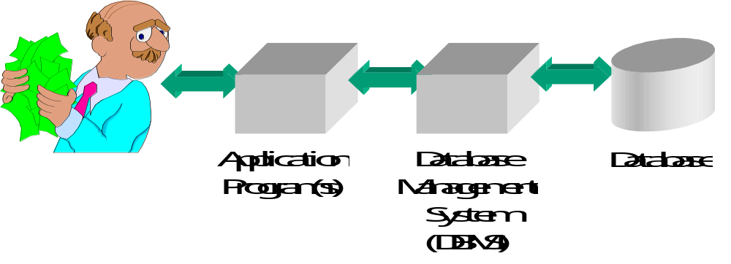
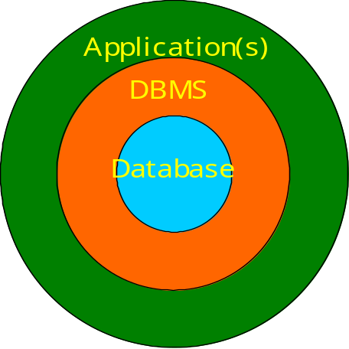
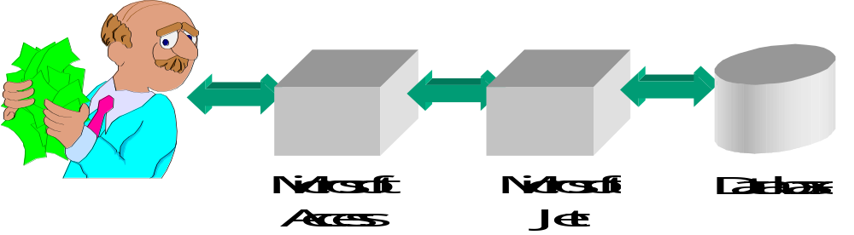
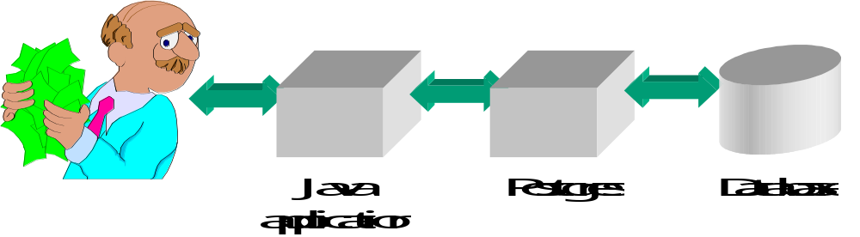
What’s the set-up then?
“I can see a database”

Slide 6
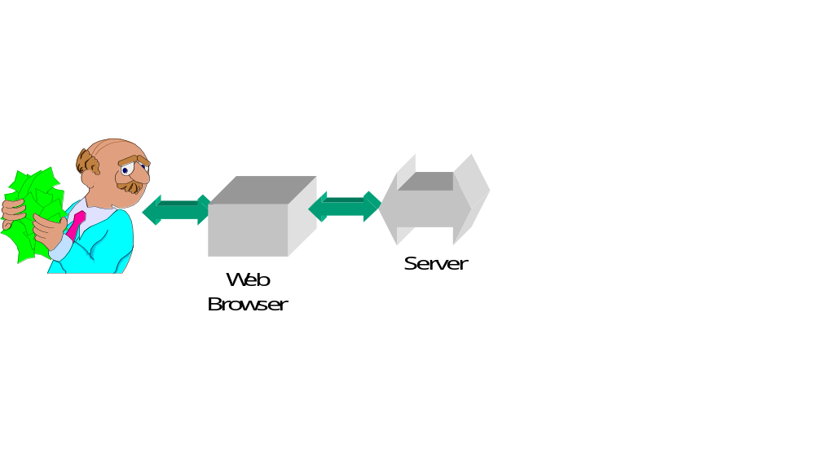
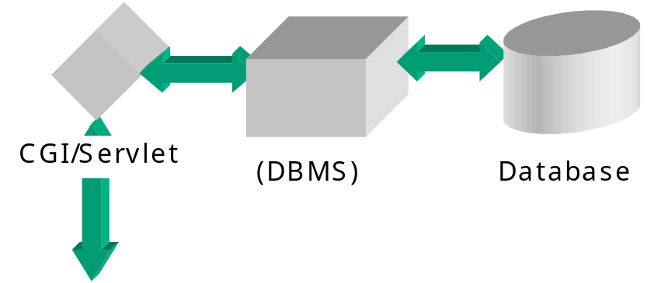
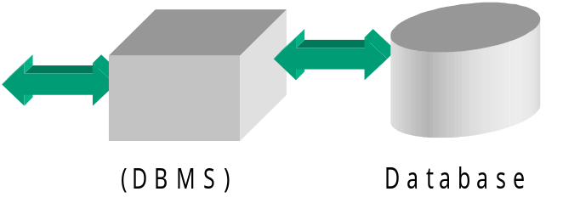
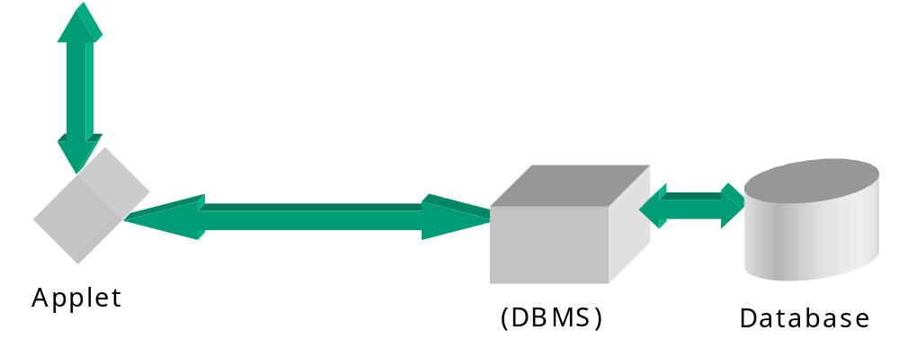
… or the web

Slide 7
Solid mathematical theory underlies it
Reasonably approachable!
Has not been without developments and controversy
  Some variations therefore
A model for other parts of CS

Slide 8
Mathematical theory ...
Theory does not lead to “recipes”
  A practitioner develops:
    An understanding of the theory
    A healthy questioning of design “rules”
    Experience to recognise and create effective designs
DB design is sometimes described as “applied common sense”
  This is unfair to new-comers
  … but it has some basis!

Slide 9
Designing & building DBs in DBMSs (overview)
Requirements definition
  As elsewhere - Some specialised techniques
Design the database
  Good guidelines from the theory
  Well recognised techniques
Design the database application(s)
  Good support from the DBMS engine
  DB environment or a general programming

Slide 10
Designing and building ...
Implementation
Testing/acceptance etc.
(Data entry)
  may be on-going
  may be up-front
Maintenance/enhancement
  significant part of many systems
  what DB are about in some ways

Slide 11
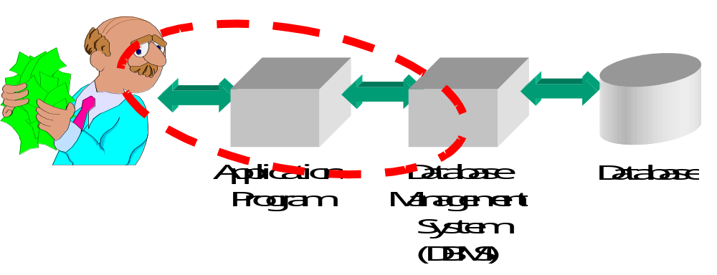
What are we studying?
What DBMS facilities might exist
How to use DBMS facilities
How to produce application programs

